Slide 1
Employee Data Analysis using Excel
STUDENT NAME: TAMILARASAN S
REGISTER NO: 312219270 (asunm1709312219270 )
DEPARTMENT: III – B.COM (GENERAL)/COMMERCE
COLLEGE : LAKSHMI BANGARU ARTS AND SCIENCE COLLEGE

Slide 2
PROJECT TITLE
Employee Data & Performance

Slide 3


AGENDA
Problem Statement
Project Overview
End Users
Our Solution and Proposition
Dataset Description
Modelling Approach
Results and Discussion
Conclusion
3/21/2024 Annual Review

Slide 4

PROBLEM STATEMENT * Analysis data : The data is taken for the purpose employee data, because While many companies collect various forms of employee data, such attendance records, performance reviews, and training completion, this data often remains underutilized. * Data Silos: Employee data is stored in different system, such as HR software, performance management tools, and spreadsheets, making it difficult to get a unified view of an employee’s performance. * Inconsistent Performance Metrics: There is no standardized approach to measuring employee performance across different departments, leading to inconsistent evaluations and potentially biased decisions.

Slide 5

PROJECT OVERVIEW Project Objective: The primary goal of this project is to develop a comprehensive system to collect manage, and analyze employee data to enhance performance management, optimize workforce productivity, and inform strategic decision-making. Scope of the Project: Data Collection: Gather data on employees from various sources such as HR records, performance reviews, attendance systems, and project management tools. Data Management: Develop a centralized repository for storing employee data securely and ensuring easy access for authorized personnel. Performance Analysis: Create metrics and KPIs to measure employee performance, track progress over time, and identify areas for improvement. Reporting and Visualization: Generate dashboards and reports that provide insights into employee performance trends, high-performing individuals, and departments that may need support.
.

Slide 6

WHO ARE THE END USERS? HR Managers and Professionals: They use employee data to manage payroll, benefits, recruitment, onboarding, compliance, and other HR functions. Performance data is used for evaluating employee productivity, conducting performance reviews, and implementing training and development programs. Team Managers and Supervisors: Managers use this data to understand how their team members are performing, identify high performers and those needing support, and make informed decisions about promotions, rewards, and disciplinary actions Employees: Employees themselves may access their own data and performance feedback to understand expectations, track their own progress, set personal goals, and engage in self-improvement. Finance Departments: They might use employee data for budgeting purposes, payroll processing, and financial planning. Understanding the cost of the workforce and performance ROI is critical for financial forecasting.

Slide 7

OUR SOLUTION AND ITS VALUE PROPOSITION Data Import and Integration: Seamless import of employee data from various sources (HR systems, payroll, attendance, etc.). Integration with existing HR and performance management systems. Pivot Table Summaries: Ability to create pivot tables for summarizing employee data across different dimensions such as departments, roles, or time periods. Easily analyze key performance indicators (KPIs) by aggregating data to find insights. Graph and Data Visualization: Dynamic graphing capabilities to visualize trends and patterns in employee performance. Support for various chart types (bar, line, pie, scatter, etc.) to suit different analysis needs. Interactive dashboards that provide real-time updates and drill-down capabilities.

Slide 8
Conditional Formatting: Use of conditional formatting to highlight key metrics (e.g., low performance, high absenteeism). Visual cues (colors, icons) to make it easier to spot trends and anomalies Data Export and Sharing: Export options for reports and dashboards in various formats (Excel, PDF, CSV). Easy sharing of insights with stakeholders through email or cloud-based platforms. Performance Tracking and Reporting: Customizable performance tracking templates that align with company goals and metrics. Automated report generation to save time and provide consistent performance reviews. Advanced Filtering and Sorting: Custom filters to view data based on specific criteria (e.g., by department, job role, performance score). Ability to sort data to highlight top and bottom performers.

Slide 9
Dataset Description Employee Information: Employee: Kaggle 26 Feature 9- Feature Emp Id No: In kaggle employee no Name - text of employee name Emp type: Permanant , temprary, contract. Pertofrmance level : employee performance rating ( very high , high, medium, low) Gender : Male ,Female Location code: Location code of the working place Employee rating num- maximum 5

Slide 10

THE "WOW" IN OUR SOLUTION
Intuitive and User-Friendly Interface:Dashboard Design: Use a clean, modern, and intuitive design for dashboards that provide real-time insights. Implement easy-to-navigate interfaces with customizable views so that employees and managers can access relevant data quickly.
Visual Analytics: Include visually appealing charts, graphs, and infographics to make data easy to understand at a glance. Interactive elements like drag-and-drop filters or hover-over details can enhance the user experience.
AI-Powered Insights:
Predictive Analytics: Use AI to predict future trends in employee performance, potential turnover, and other key metrics. This can help in proactive decision-making.
Performance level = IFS(Z8>=5,”VERY HIGH”,Z8>=4,”HIGH”,Z8>=3,”MED”,TURE,”LOW”)
3/21/2024 Annual Review
10

Slide 11
MODELLING
Data Collection:
1) The data is collected from the kaggle
2) Performance Metrics KPIs, productivity measures, goal achievements.
3)Employee Information Basic demographics, job roles, tenure, etc.
Feature Collection
1)Personal and Demographic Information
2)Job-Related Information
3)Performance Metrics
Data cleaning
1)Identify Data Sources
2)Data Quality Assessment
3) Handle Missing Values
4)Correct Data Entry Errors
11

Slide 12
Summary:
1)An employee data and performance summary typically includes key information that gives a comprehensive overview of each employee's role, achievements, and contributions to the organization. Here's a breakdown of what such a summary might include
2) It is useful for the purpose of easlly acess by the HR and managning directors. with the source of documentation. Analysis the resource of the employee
Performance Level
1)Key Performance Indicators (KPIs)
2)Performance Appraisals
3) Goals and Objectives Tracking
Visulazation
1)Bar Charts
2)Line Charts
3)Pie Charts
4)Bubble Charts

Slide 13
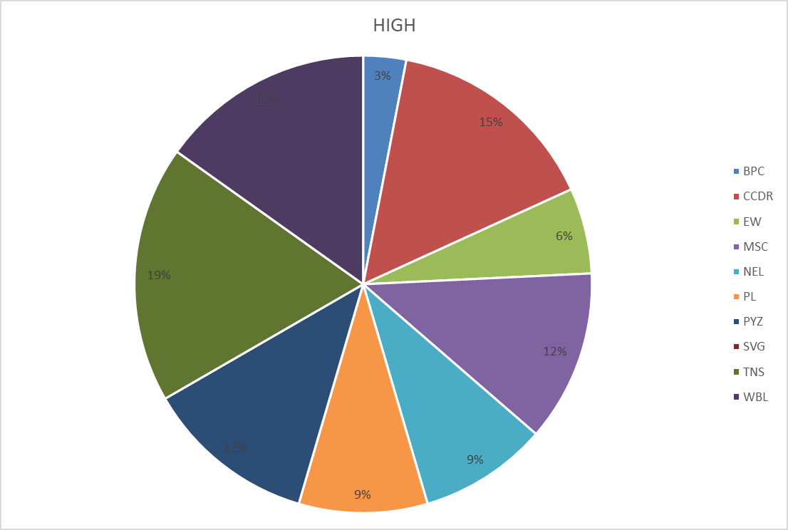
RESULTS
13

Slide 14
Conclusion Visualizing employee data and performance is a critical practice that enables organizations to gain insights into workforce dynamics, identify areas for improvement, and make data-driven decisions. By utilizing various visualization tools and techniques, organizations can transform complex data sets into easily interpretable visual formats, fostering better understanding among managers and decision-makers. In conclusion, the effective visualization of employee data and performance is an invaluable tool for optimizing workforce management, enhancing productivity, and driving business success. By leveraging the right visualization techniques and tools, organizations can turn raw data into actionable insights, leading to better outcomes for both employees and the organization as a whole

